Slide 1
DRIVER DROWSINESS DETECTION
Name :- Aayush Barfa
Roll no :- 18419MCA001
Class :- MCA 5th Sem
Under the Guidance of :- Prof. Gourav Baranwal Sir

Slide 2
Content
Problem Description
Methodology
Implementation
Literature Survey
Identifying issues
Addressing issues
Conclution

Slide 3
Problem Description
Various studies have suggested that around 20% of all road accident are fatigue-related. The main aim of this is to develop a drowsiness detection system by monitoring the facial expression; it is believed that the symptoms of driver fatigue can be detected early enough to avoid a car accident. Detection of fatigue involves the observation of eye movements and blink patterns.

Slide 4
Driver drowsiness detection is a car safety technology which helps to save the life of the driver by preventing accidents when the driver is getting drowsy.
The main objective is to first design a system to detect driver’s drowsiness by continuously monitoring the eye.
The system works in spite of driver wearing spectacles and in various lighting conditions.
To alert the driver on the detection of drowsiness by using buzzer or alarm

Slide 5
Methodology :
First, we’ll set up a camera that monitors a stream for faces.
If a face is found, we apply facial landmark detection and extract the eye regions.
Now that we have the eye regions, we can compute the eye aspect ratio to determine if the eyes are closed.

Slide 6
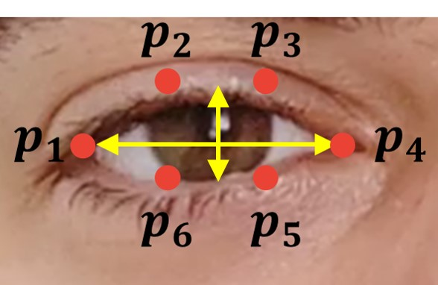

Slide 7
If the eye aspect ratio indicates that the eyes have been closed for a sufficiently long enough amount of time, we’ll sound an alarm to wake up the driver.

Slide 8
Implementation of extra functionalities and new Idea
Yawn detection :
Yawn Detection is all about detecting yawn( open one’s mouth wide and inhale deeply due to tiredness or boredom). It can be used in various major applications like Self Driving Cars, Driver’s Fatigue detection, Driver’s Drowsiness detection, Driver’s consciousness detection etc.

Slide 9
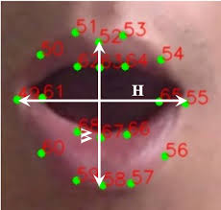
We will calculate the mean distance between upper and lower lips and check it with threshold.

Slide 10
Libraries Used
Face Recognition
OpenCV
Scipy
Playsound
Numpy
Threading

Slide 11
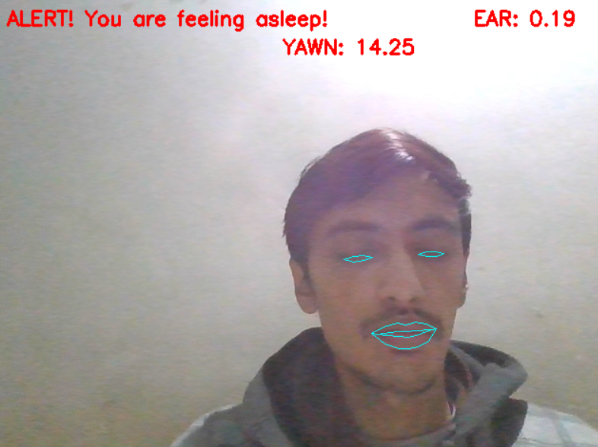
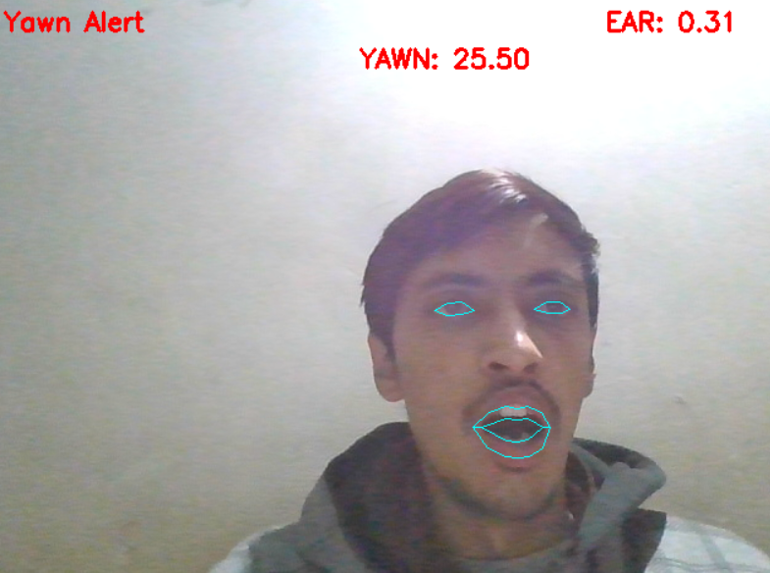
Implementation

Slide 12
Literature Survey :
Sn. No. | Author | Journal | Topic | Date | Methodology | Issues
01 | V Triyanti and H Iridiastadi | Open Access proceedings Journal of Physics | Challenges in detecting drowsiness based on driver’s behavior | june 2017 | Detect Drowsiness in Driver using brainwave, heart rate and electric signals from muscle cells | other factors should also be considered, including the environment and driving behavior itself
02 | Sukrit Mehta, Sharad Dadhich, Sahil Gumber, Arpita Jadhav Bhatt | SSRN | Real-Time Driver Drowsiness Detection System Using Eye Aspect Ratio and Eye Closure Ratio | feb 2019 | Proposed Drowsiness Detection Algorithm using facial landmark | can be e extended for different types users such as bike riders or in different domains like railways, airlines etc
03 | Mohamad-Hoseyn Sigari Mahmood Fathy and Mohsen Soryani2 | IJVT | A Driver Face Monitoring System for Fatigue and Distraction Detection | 14 Jan 2013 | fuzzy logic | face tracking method which is inaccurate and very computationally complex.

Slide 13
Identifying issues:
Face should be in light otherwise is will not be able to detect eyes.
Some peoples have already very small eyes so we need to minimise eye aspect ratio in that case.

Slide 14
Addressing the issues:
Implemented yawn detection by which if in any situation drowsiness detection is not working than yawn detection can also help in that case.

Slide 15
Conclusion:
In this work, a real time system that monitors and detects the loss of attention of drivers of vehicles. Non-intrusive methods have been preferred over intrusive methods to prevent the driver from being distracted due to the sensors attached on his body. Accuracy of this proposed system improves with the increase in brightness of the surrounding environment. The work can be extended for different types users such as bike riders or in different domains like railways, airlines etc.

Slide 16
Thank you

